Slide 1
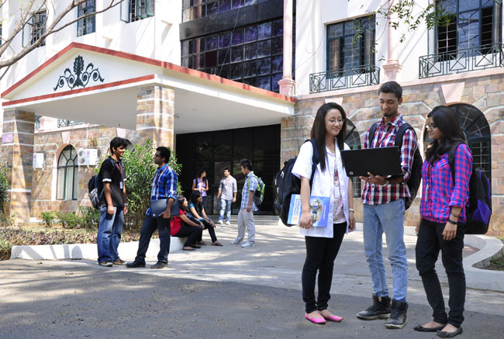

CSB4201 - DESIGN AND ANALYSIS AND ALGORITHMS
B.Tech – III Semester – Unit I
Dr. J. Thangakumar
Associate professor
School of Computing Sciences,
Department of Computer Science and Engineering
Mr. M Sambath
Assistant Professor(SG)
School of Computing Sciences,
Department of Computer Science and Engineering

Slide 2
Topic : Time complexity

Slide 3
Time Complexity : Time the program takes to complete the execution. Types: Best Case Time Complexity: Efficiency of an algorithm for an input of size N for which the algorithm takes the smallest amount of time. Average Case Time Complexity: It gives the expected value of T(n). Average case is used when worst case and best case doesn’t gives any necessary information about algorithm’s behavior, then the algorithm’s efficiency is calculated on Random input. Worst Case Time Complexity: efficiency of an algorithm for an input of size N for which the algorithm takes the longest amount of time.

Slide 4
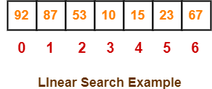

Slide 5
Time complexity is calculated on the basis of Operation Count: Find the basic operation ; it takes 1 unit of time

Slide 6
for (i = 0; i < n; i++) { printf(“%d”,arr[i]); } The Step count for “i=0‟ = 1 The step count for, “”i<n” = n + 1 The step count for, “i++‟ = n The step count for, “printf‟ = n Total steps = 1+[n+1]+[n+1] + n = 3n+2

Slide 7
Time complexity of a function (or set of statements) is considered as O(1) if it doesn’t contain loop, recursion and call to any other non-constant time function. // set of non-recursive and non-loop statements For example following statement has O(1) time complexity. sum=sum+1;
O(1)

Slide 8
for (i = 1; i <= n; i += 1) { // some O(1) expressions }
O(n)

Slide 9
for (i = 1; i <=n; i++) { for (j = 1; j <=n; j++) { // some O(1) expressions } }
O(n²)

Slide 10
for (i = 1; i <=n; i++) { for (j = 1; j <=n; j++) { for (k = 1; k <=n; k++) { // some O(1) expressions } } }
O(n³)

Slide 11
O(Logn) Time Complexity of a loop is considered as O(Logn) if the loop variables is divided / multiplied by a constant amount. for (int i = 1; i <=n; i *= 2) { // some O(1) expressions }
O(log n )

Slide 12
int a = 0, b = 0; for (i = 0; i < N; i++) { a = a + 3; } for (j = 0; j < M; j++) { b = b + 4; }
O(N * M) time, O(1) space
O(N + M) time, O(N + M) space
O(N + M) time, O(1) space
O(N * M) time, O(N + M) space
Practice problem 1
1. O(N * M)
2. O(N + M)
3. O(N - M)
4. O(N / M)

Slide 13
int a = 0; for (i = 0; i < N; i++) { for (j = N; j > i; j--) { a = a + i + j; } }
Practice problem 2
Options:
1. O(N)
2. O(N*log(N))
3. O(N * Sqrt(N))
4. O(N*N)

Slide 14
int i, j, k = 0; for (i = n / 2; i <= n; i++) { for (j = 2; j <= n; j = j * 2) { k = k + n / 2; } }
Practice problem 3
1. O(n)
2. O(nLogn)
3. O(n^2)
4. O(n^2Logn)

Slide 15
int a = 0, i = N; while (i > 0) { a += i; i /= 2; }
Practice problem 4
1. O(N)
2. O(Sqrt(N))
3. O(N / 2)
4. O(log N)

Slide 16
THANK YOU

